Slide 1
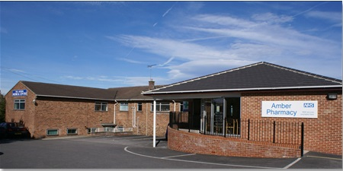
Arthur Medical Centre
Patient Participation Group

Slide 2
Agenda
Review of Previous Meeting
Practice Update inc building (general) (AC)
Potential vaccination support/programme/age groups
Members Feedback
Phlebotomy Status
AOB

Slide 3
Arthur Medical Centre
General Updates

Slide 4
Staff Updates
Dr Jennifer Dickinson – has been on long term sick - last day 23rd Oct
Joy Simpson (ACP) leaves mid-October
Dr Britt ter Horst joins the practice on 1st Nov. Dr ter Horst is a newly qualified GP and will be working with AMC for 5 x sessions
We have made an offer to a new ACP to replace Joy’s hours
ACP Christine Duffy deployed to Army Reserve in March – returns in Nov
Dr Justine Horton long term Mat cover Locum. Dr Nasim Akhtar, Dr Farah Ghafoor, Dr Rowan Chamberlain and Dr Ayyub Mirza regularly consulting

Slide 5
Staff Updates
Registrars
Dr Mahmoud Ali (will be here for 12 months)
Dr Israel Abia
Dr Stacey Walklett

Slide 6
Staff Updates
Care Navigation
2 x new Care Navigators (receptionists) start this month

Slide 7
Key Performance Indicators
Patient list = 9,117 patients as of this morning
Over the last 4 weeks, Arthur Medical Centre has:
handled 4,236 incoming telephone calls (an average of 212 calls handled per working day). This compares to 3,670 calls over the same period last year (183 oer day) – an increase of 15%
provided 3,233 patient appointments in total (an average of 162 per working day)
Of these appointments, 1,879 were face-to-face appointments (an average of 99 per working day and around 55% of the total)

Slide 8
Key Performance Indicators
DNAs
Over the month of April, 65 patients did not attend their appointment and did not give notice of cancellation.
This represents 16 hours of wasted appointment time – BUT is nearly half the figure of previous months.
This is largely to do with efforts on Long Term Conditions

Slide 9
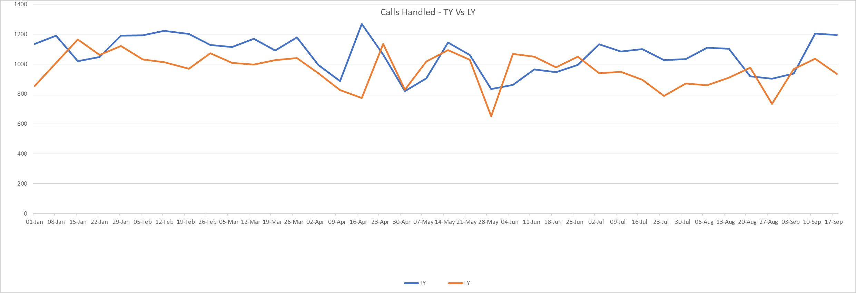
Incoming Call Volumes 2022/3 Vs 2021/2

Slide 10
Arthur Medical Centre
‘Town Hall Meeting’

Slide 11
Patient Meeting 21st June 2023
Contrary to our fears (and to the opinions of every other practice we spoke to), the Patient Meeting was a success!
We would like to give a massive
THANK YOU
to all of you for supporting this effort and for helping us present our practice in the best way.

Slide 12
Post meeting feedback
“Very informative and professionally delivered brief. It has certainly has opened my eyes to the amount of hard work you and your team put in to ensure the medical centre runs smoothly.”
“Just to say how much it was appreciated to join you and Dr Wilton at the Zoom meeting this evening, which was both informative and helpful in understanding the working of the Practice and Primary Care Trust.”
“Thank you so much for arranging it and thank your staff for their time and effort in participating, I sincerely hope you all felt it useful too.”
“It would be good to have insight into your team”
“Good to get understanding of how allied health professionals can help and what other services can be offered”

Slide 13
Building work
Funding now agreed in principle with the ICB and NHSE
Finance agreed with bank for remainder
Architect’s plans complete and have gone to Planning Permission/Building Control. Work begins in earnest once complete (Any political support would be welcome!)
New heating system to begin install in October
Anticipate ground works begin in January with work complete by June
Net outcome 5 x new clinical rooms

